Slide 1
Ideas for that “Hard” Health Information Technology Module
Health Science Teachers
Dr. Ellen Katzowitz and Dr. Erika Ijames-Wilson
Esquared Educational Experiences
Esquaredhomeschool.com

Slide 2
General Disclaimers
The lessons we are teaching can be found in multiple courses and are often Repeating standards; therefore, some of our ideas may have been done in previous courses
Yes, we have always said the everything old is new again. We are experienced teachers that have taken some old ideas and modernized and improved on them. However, for the most part these ideas are “brand, spanking” new
Safety is of the utmost. Make sure students are monitored at all times when performing activities. There might not be many or any of these types of activities
Before performing and after every activity make sure you stress to your students their hands should be washed
Rubrics should be used only if they apply to you and your class. Sometimes, the teachers have skills sheets/competencies which are better suited to evaluate students

Slide 3
Standards for this Webinar
National Health Science Standards
5.2 Legal Practices
5.2.1 Apply standards for the safety, privacy and confidentiality of health information.
HIPAA
Privileged communication
11.1 Key Principles, components and practice of Health Information Systems
11.11 Identify components of an electronic health record (EHR) and/or electronic medical record (EMR).
History and physical
Medications
Patient demographics

Slide 4
Standards for this Webinar Cont.
Progress notes
Treatment Plan
11.12 Explore different types of health data collection tools.
Telemedicine/telehealth
11.13 Create electronic documentation that reflects timeliness, completeness, and accuracy.
11.14 Create documentation in EHR/EMRs that reflect timeliness, completeness, and accuracy.
11.15 Adhere to information systems policies, procedures, and regulations as required by national, state, and local entities.
11.2 Privacy and Confidentiality of Health Information
Apply fundamentals of privacy and confidentiality policies and procedures (HIPAA)

Slide 5
Activities
There has to be information given to the teacher. This is not our usual way. Sorry
Explain terminology from these standards in “layman’s terms”
Role play telemedicine by making a virtual appointment, etiquette, and asking actual questions by the students
Activity for students using HIPAA violations
Matching activity using codes and diagnosis

Slide 6
HIPAA Practices/Violations
HIPAA (Health Insurance Portability and Accountability Act)
Federal law that was enacted in 1996 in order to protect patient health information from being released without the patient’s permission
Most of you that have worked in healthcare have seen stricter HIPAA mandates throughout the years
This is followed by: most healthcare providers including doctors, clinics, hospitals, nursing homes, etc.

Slide 7
HIPAA Practices/Violations Cont.
Health plans including health insurance companies, HMOs, Medicare, and Medicaid are just some organizations that must follow HIPAA
HIPAA form signed is required from physician’s offices (provided on following pages). Patients are told it’s the privacy form (most not knowing what they sign). Who reads these forms anyway?

Slide 8
HIPAA Practices/Violations Cont.
Patients who need their records/MRIs/lab results/X-rays, etc. that need their results to transfer from one provider to another must also sign a HIPAA release (provided on following pages)
In essence, HIPAA allows patients to control the use and release of their health information. Patients have the right to see and receive copies of their medical information which are kept up to date by different health plans and the patient’s healthcare provider

Slide 9
HIPAA Practices/Violations Cont.
The following are some HIPAA violations:
Gossiping
Carelessness
Theft
Hacking
Many other ways to violate HIPAA even if done without malicious intent.
In 2019, there were over 400 HIPAA violations reported which lead to almost 35 million Americans that had their **** Protected Health Information(PHI) breached (about 10% of US population)
Notes:
Specialists should be hired that access the technology and find problem areas. The specialists are trained to take action to protect data.

Slide 10
Two of the Many of My Personal Experiences with HIPAA Violations
I was taking physical therapy at a large facility. I had several physical therapists. One day I had a PT that worked only part time at this facility. I had never had this person before. The PT worked at another facility full time. When the PT came to greet me, I was told that since my last name is uncommon, the PT asked the supervisor at the full-time job (having the same last name) if I was any relation. We are related.
What would you do? This question can be discussed with your students after explaining about HIPAA

Slide 11
Two of Many of My Personal Experiences with HIPAA Violations Cont.
This event happened in 2021. I was at my physician’s office speaking with the specialist in charge of getting specialized shots for patients. She asked me if I remembered her cousin who happened to be a student of mine a few years ago. The specialist knew where I had taught. She told me about her cousin which I was happy to hear about. I asked her if she told her cousin of her and my connection, and she said her cousin knew
What should I have done? Another question that can be discussed with your students

Slide 12
HIPAA Form for a Patient to Sign Upon First Visit to a Healthcare Provider
Instructions: This form is to be used by a patient or a legal representative on the first office visit. This gives directions for the patient to release their information other family members. Print legibly: each section needs to be completed in order to be authorized
E² Educational Experiences HIPAA Compliance Patient Consent Form
Our notice of Privacy Practices provides information about how we may use or disclose protected health information.
The notice contains a patient’s rights section describing your rights under the law. You ascertain that by your signature that you have reviewed our notice before signing this consent.
The terms of the notice may change, if so, you will be notified at your next visit to update your signature/date.
You have the right to restrict how your protected health information is used and disclosed for treatment healthcare operations. We are not required to agree with this restriction, but if we do, we shall honor this agreement. The HIPAA Health Insurance Portability and Accountability Act of 1996) law allows for the use of the information for treatment, payment, or healthcare operations.
By signing this form, you consent to our use and disclosure of your protected healthcare information and potentially anonymous usage in a publication. You have the right to revoke this consent in writing, signed by you. However, such a revocation will not be retroactive.
By signing this form, I understand that:
Protected health information may be disclosed or used for treatment, payment, or healthcare operations.
The practice reserves the right to change the privacy policy as allowed by law.
The practice has the right to restrict the use of the information but the practice does not have to agree to those restrictions.
The patient has the right to revoke this consent in writing at any time and all full disclosures will then cease.
The practice may condition receipt of treatment upon execution of this consent.
May we discuss you medical condition with any member of your family? YES NO
If YES, please name the members allowed:
__________________________________ ______________________________________
__________________________________ _______________________________________
This consent was signed by:_____________________________________________________________________ ( Print name please)
Signature: ________________________________________ Date: __________________
Emergency Contact: _______________________________________________________
Phone Number: _________________________________________________
Notes:
Click on other

Slide 13
HIPAA Form for a Patient to Sign of Release Information to a 3rd Party
Instructions: This form is to be used by a patient or a legal representative to permit the release the release of information to a third party, such as an insurance company, employer, or for other legal purposes. Print legibly: each section needs to be completed in order to be authorized.
E² Educational Experiences HIPAA AUTHORIZATION FORM
I, ___________, hereby authorize the use or disclosure of my protected information as described below:
1. AUTHORIZED PERSONS TO USE AND DISCLOSE PROTECTED HEALTH INFORMATION
__________________ is authorized to disclose the following protected health information to __________________of _________________, _______________
2. DESCRIPTION OF INFORMATION TO BE DISCLOSED
The health information that may be disclosed is:
____________________________ __________________________ ____________________________
All past, present, and future periods of health care information may be shared.
3. PURPOSE OF THE USE OR DISCLOSURE
The purpose of this use or disclosure is __________________________
4. VALIDITY OF AUTHORIZATION FORM
This Authorization Form is valid beginning on _________________ and expires on _________________.
5. ACKNOWLEDGMENT
I understand that the information used or disclosed under this Authorization Form may be subject to re-disclosure by the person(s) or facility receiving it and would then no longer be protected by federal privacy regulations.
I have the right to refuse to sign this Authorization Form. If signed, I have the right to revoke this authorization, in writing, at any time. I understand that any action taken in reliance on this authorization cannot be reversed, and my revocation will not affect those actions.
By: _______________________________ Date:________________

Slide 14
FYI
E² Educational Experiences works with an agency to certify students in HIPAA and OSHA
Basically, its about a 30 to 40 minute course. There will be a test administered, and if the student passes the test, they will be issued a certificate for HIPAA and/or OSHA certification
This is great for a resume, transcript, job application, etc.

Slide 15
HIPAA Violations – Yes or No? Student Activity
Directions: This can be done as a group activity of 3 or 4 students. The following are scenarios that can be HIPAA violations or not HIPAA violations. Indicate which one is a violation or not. Explain why.
****We have more in our Health Informatics module on our website
Scenario 1: An employee from an orthodontist’s office was reviewing patient reviews on Yelp, a social media platform which rates and reviews businesses. The response divulged confidential information which included the patient’s name, treatment, and also facts about the patient’s insurance and cost of treatment. HIPAA violation or not?
Answer to Scenario 1: This was a true story and a HIPAA violation. There was no reason listed why the employee gave out this private information. Perhaps, it was carelessness. The office was sued
Scenario 2: This happened in the laboratory where I worked in 1994. A group of laboratory technologists were discussing a patient in the cafeteria. The patient did not have a diagnosis yet. They were comparing laboratory values and trying to figure out why the patient had the particular symptoms related to the lab values. Unbeknownst to them, the patient’s family was sitting at and nearby table and heard the conversation. HIPAA violation or not?
Answer to Scenario 2: This is not a HIPAA violation. The date was 1994 before HIPAA was enacted. However, the family members complained, and the laboratory techs were reprimanded
Notes:
Click on other

Slide 16
EMR (Electronic Medical Record) versus EHR (Electronic Health Record) YIKES!
These are not interchangeable!!!!!
What is the difference between them?
EMRs are the digital versions of paper charts in the physician’s office. It comprises the medical and treatment history of the patient in one office. Sometimes – no better than a hard copy of patient records
EHRs do all of that and more. They stress the patient’s total health – more than just the medical info obtained in the physician’s office. They are meant to share information with other health care providers (think laboratory, other doctors, and radiology, etc.) EHRs are intended to be kept by all people involved with the patient including the patient. Now – what do we have? We have a team of all the clinicians involved in the patient’s well being
Notes:
EMRs - It can be printed out and sent to another group
EHR – think Emory

Slide 17
EMR versus EHR Cont.
Many things have become common in the last several years with EHRs
Patient Portals – patients can communicate with the nurses and doctors of a group. Patients can also see the results concerning the latest visit –lab results, medication, etc.
Pharmacists can see the medications prescribed by a physician to the patient. Therefore, any contraindicated medications can be flagged
To summarize, both are digital records of patient’s medical information. An EMR is considered a digital version of a patient’s chart. The EHR contains the patient’s records from different doctors and facilities to provide a long-term all-inclusive view into the patient

Slide 18
Some parts of an EMR and EHR
Diagnostic tests - help physicians remember results outside of normal values
History and Physical – A medical record covers the lifetime of a patient – a record that is longitudinal from which reports can be created over time
Medications
Demographics – to include age, race, gender, ethnicity, etc. When demographics are understood, decisions can be made based on a patient’s needs
Treatment plan – a living document following the patient throughout the healthcare systems which shows growth toward patient goals.
Notes:
Medications – EHRs can help facilities prevent unfavorable medication events. Pharmacists can read physicians’ handwriting. Avoids errors
Ethnicity – many times ethnicity and /or gender, or race may increase predisposition to a disease

Slide 19
Health Informatics/ Health Information Management/Medical Office Procedures
Who can explain the difference?
What is health informatics? Simply, a phrase that describes acquiring, storing, retrieving and using a patient’s health information to support cooperation among the patient’s different healthcare providers. This relatively new field connects information technology, communication, and the healthcare occupations. Ultimately, this becomes a digital format, and it is used in order to better the well-being of the patient

Slide 20
Health Information Technology (HIT)
Do not think so much about this
This can be as simple as checking in patients electronically, or updating their medical records, or even sending information such as blood work to a patient in the portal
HIT is the part of healthcare that supervises the different technology systems that healthcare providers use to handle patient information
This could be private facilities as well as public clinics, hospitals, and doctor’s offices
Notes:
HIT keeps all of these systems running efficiently.

Slide 21
Health Information Technology (HIT) Cont.
Here’s the confusing part (to me)
HIT uses technology such as EHRs including technology tools which allow patients to meet their health goals such as dieting, controlling blood pressure, exercising, etc.
Patients are given more power over their health through different applications and improved access to information. Increase advances in this field are allowing peoples of the health care team have better communication
Completely different roles in HIT other than focusing on patients is traditional technology work – maintaining computers, maintaining HIPAA with encryption of records, designing computer networks

Slide 22
Health Information Technology (HIT) Cont.
Bottom line right here - HIT presents many opportunities for improving and changing healthcare from soup to nuts – decreasing human error, improving clinical outcomes, tracking patient information over time, etc.
OK – last time. The difference between health informatics and health information technology is that informatics is concerned with managing the databases of patients, whereas health information is affected with managing the data

Slide 23
Telemedicine standard which will combine with many other standards in this PowerPoint
What is telemedicine?
Permits healthcare providers to access, diagnose and treat patients from a distance using telecommunications technology. This uses real-time telemedicine which makes it easy to do a doctor-patient visit anytime, or anywhere. This is sometimes interchanged with telehealth. But telehealth is a broader term than telemedicine, and in addition to telemedicine it also includes continuing medical education online and consumer type applications. There are basically three main categories of telemedicine. The one we will concentrate on is:
Teleconsultation – this is an online visit where a consultation between the doctor and patient take place (or in the days of Covid – PTs, OTs, SLPs, and many others). This is usually done by videoconferencing technology. Some of these include Zoom, Mend, Doxy.me, etc.

Slide 24
Telemedicine – the ins and outs
An appointment must be made with the healthcare provider. This can be done by scheduling an appointment (old school), going on the portal, or through the provider’s webpage
The patient will receive a text message with a link asking the patient to join with the provider in a secure conference call
The patient will either be connected to the physician or to a nurse or medical assistant who will ask some basic questions before being joined by the physician or healthcare provider

Slide 25
Telemedicine – the ins and outs - continued
Questions????
Its pretty simple – but what are the logistics?
If you are an established patient, the physician should have your chart during the visit
New patients will fill out forms on-line or can get the forms sent to them via US mail (old school)
Patients might have to answer questions such as vital signs, height and weight, etc.
The office person might take your payment information and insurance before or after appointment

Slide 26
Telemedicine – the ins and outs - cont.
Next – is your appointment. The health provider asks about problems, health, injuries, family history, etc.
Many health providers can easily do a telemedicine visit. For example, a gastroenterologist, family physician, psychiatrist, endocrinologist can, to name a few
There are many that cannot. If the patient has a medical condition in which the doctor would need to do a physical examination that could not be done by a telemedicine visit. A physician can order tests for the patient which can be useful, ex. Labs, MRI, X-Rays, and other hospital tests in order to diagnosis a patient

Slide 27
Telemedicine Etiquette
Telemedicine etiquette must be stressed - healthcare provider must have a quality webcam and telemedicine platform, professional space set up, webcam at eye level, dress professional, being punctual, knowing the patient’s complaint prior, having the patient’s medical chart ready, engaging the patient, and making sure the patient understands any post-appointment instructions

Slide 28
Additional Forms
This is usually on the health providers website. It can be emailed to the provider
Instead of using the phone. A medical office staff member will contact the patient
Contact Us
Submission does not guarantee availability
Submit

Slide 29
Patient Portal
In order to use the portal, the patient has to be sent a link from office, and/or set up an account

Slide 33
Student Activity – Telemedicine/Different Diagnoses/Different Providers – Role play
Directions: Designate 3 students to a group.
Part 1
One student will be the physician or provider
One student will be the patient
One student will video the telemedicine visit
If time allows, rotate students
Part 2
Students will find physicians or other providers that would be easy to telemedicine
Students will pick a patient diagnoses and research it to ask appropriate questions

Slide 34
Student Activity – Telemedicine/Different Diagnoses/Different Providers – Role play
Some examples can be physical therapists, occupational therapists, physicians such as pediatrician, psychiatrist, internist, radiologist, allergist, etc. There are many
The group will give the type of physician or provider, the type of patient, and the reason for the telemedicine visit
Using some of the forms given, all of the students have to research what each of the providers do in order to ask pertinent questions, and the symptoms of the patient
The student will also need to make an appointment, and find out how to log into the telemedicine visit
Telemedicine etiquette must be used

Slide 35
Example of the Student Activity that was done during COVID times
Madison (7 years old) was not feeling well. She was running a low-grade fever, urinating frequently with decreased urine output, and hurting upon urination
In the telemedicine visit, the pediatrician asked her mom about these symptoms and other relevant questions were asked
Not doing laboratory testing, the physician was able to determine that Madison had a urinary tract infection. The doctor phoned in a prescription, and a follow-up telemedicine visit was planned
Class Question- What questions do you think the pediatrician asked to make this diagnosis?

Slide 36
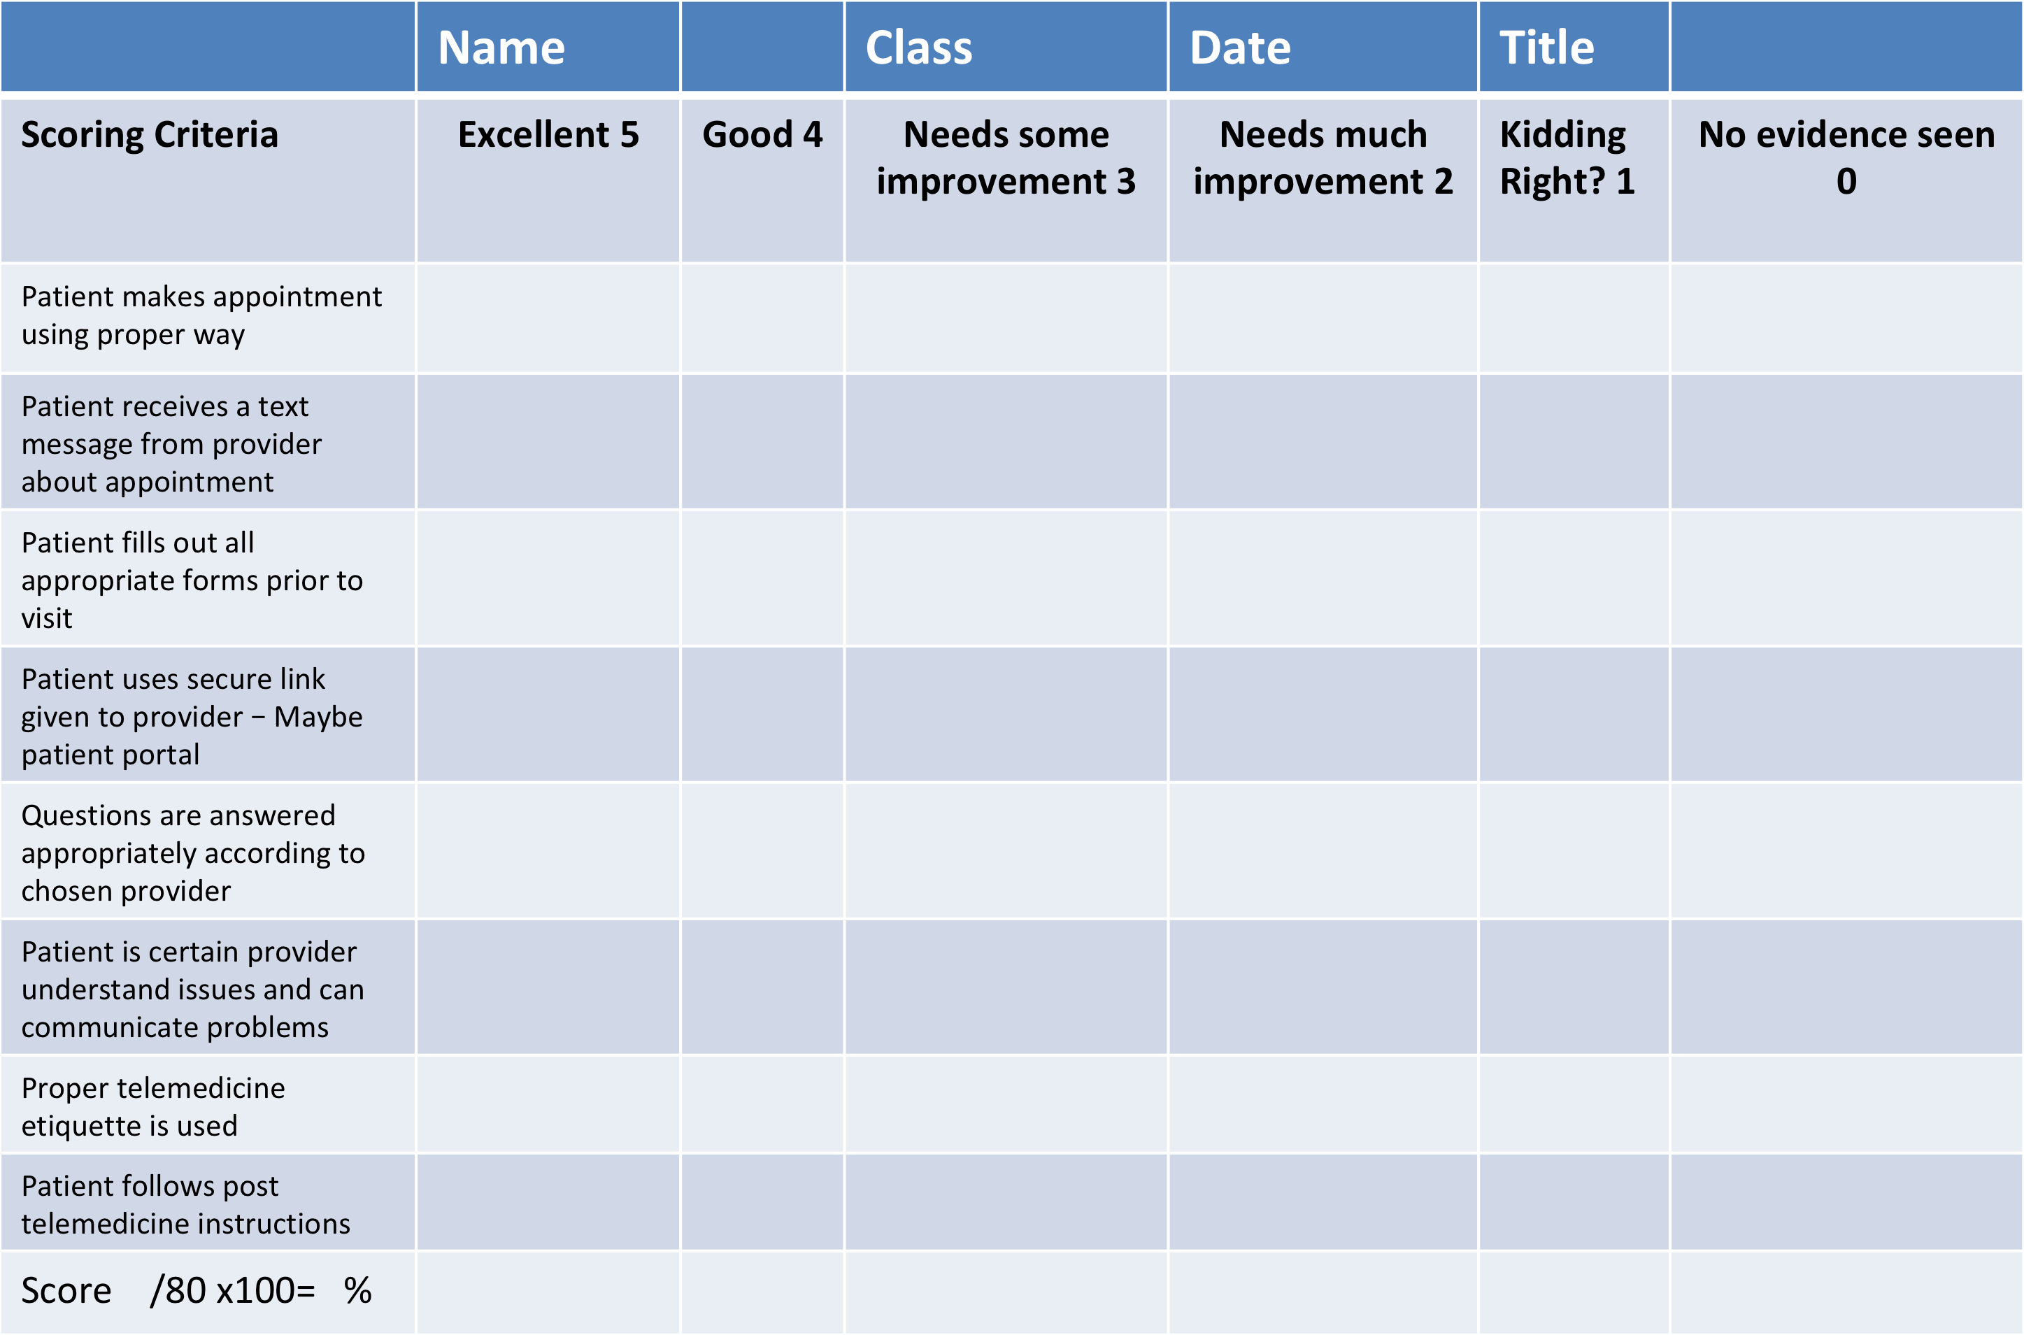
Telemedicine Student Activity Rubric - Patient

Slide 37
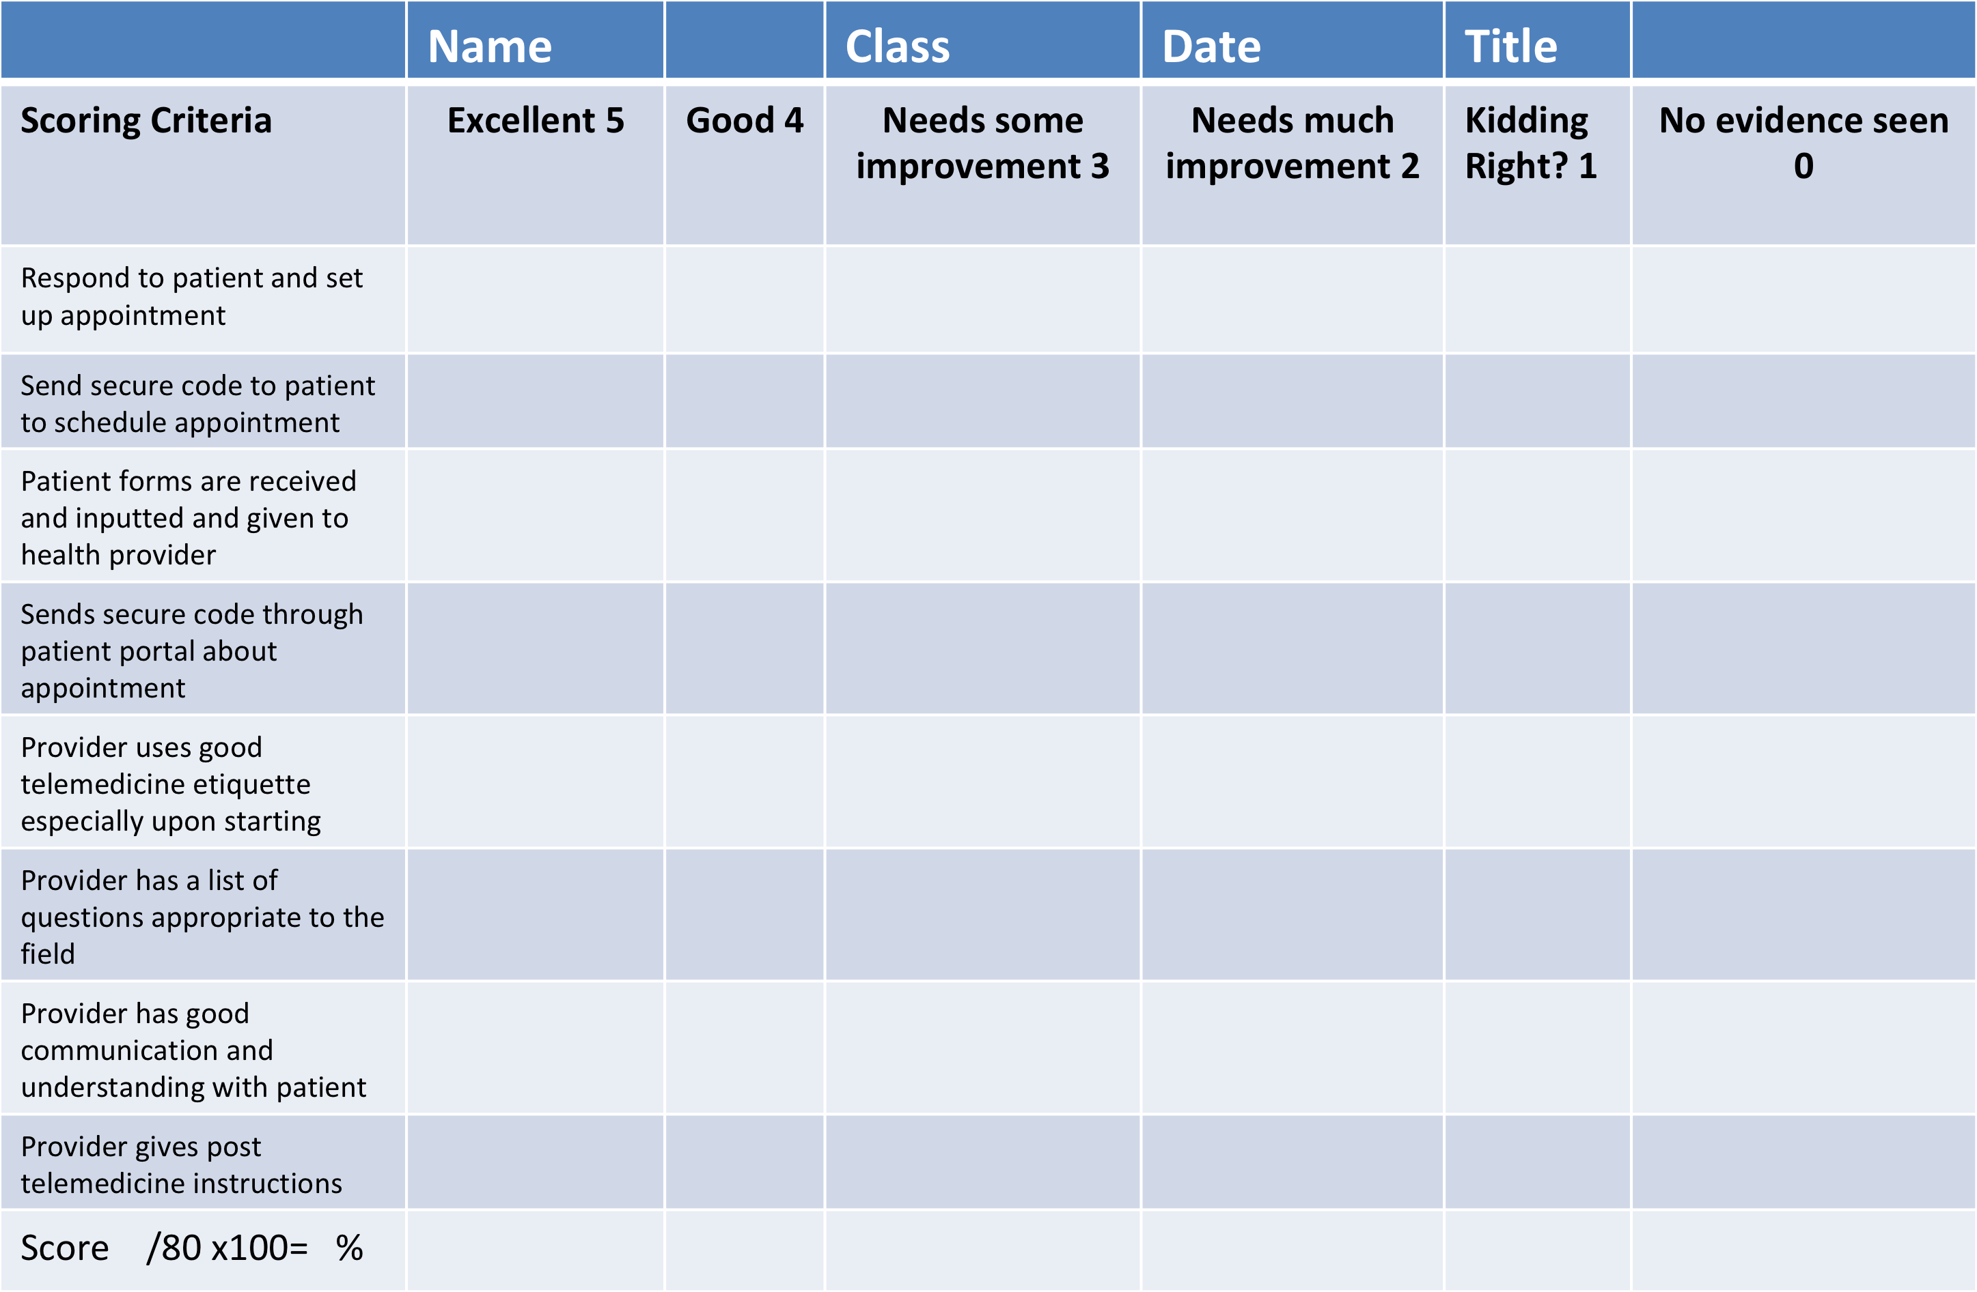
Telemedicine Student Activity Rubric – Healthcare Provider

Slide 38
Medical Coding
What the heck is medical coding?
Medical coding assigns standardized for medical procedures and diagnoses to keep massive amount of information that is generated organized
The diagnoses and procedure codes are taken for medical records documentation
Examples include transcribing doctor’s notes, laboratory results, diagnoses, etc.
The three universal systems used worldwide:
CPT (Current Procedural Terminology) - refers to a set of medical codes used by healthcare providers to describe the procedures and actions they perform. Each code represents a written description of a procedure or service which serves as a written interpretation of what was done to the patient.
For example: a COVID-19 vaccination code would be 9130

Slide 39
Medical Coding Cont.
ICD 10 CM (The International Classification of Diseases Clinical Modification) – a list of codes meant for classifying disease and an extensive variety of signs, symptoms, findings, illnesses, etc. that can cause an injury or disease
For example SO6.Ox1A is a concussion with loss of consciousness of 30 minutes or less
HCPCS – (Healthcare Common Procedure Coding System) This is a collection of standardized codes that represent medical procedures, services, supplies, and services. The codes are used to make it easier for processing such health insurance claims by Medicare, Medicaid, and other insurers
Notes:
HCPCS They used codes based on CPTs

Slide 40
Medical Coding Cont.
In order to understand the following student activity, the student needs to know how to generally code an injury. There is a Five – Step Process for diagnostic coding.
Search the alphabetical index for a diagnostic term
Check the tabular list
Read the code’s instructions
If it is an injury or trauma, add a seventh character
If glaucoma, you may need to add a seventh character

Slide 41
Student Activity Using Medical Coding
Directions: Students are to match the diagnoses with the medical code. There are coding books or books online, but one has to buy those. Have students look for the codes online (Google). After activity, there can be a class discussion about diagnoses. The diagnoses below are real.
Teachers can use many more codes using these sites:
https://www.nextech.com/blog/top-10-most-hilarious-codes-in-icd-10
https://www.healthcaredive.com/news/the-16-most-absurd-icd-10-codes/285737/
Code Diagnoses
Y93.84 a. Walked into a lamppost
W22.02 b. Burn due to water skies on fire
W61.43 c. Injured while sleeping
V97.33 d. Pecked by a turkey
V91.07 e. Sucked into jet engine
Answers 1. c 2. a 3. d 4. e 5. b

Slide 42
Social Media Information
YouTube Channel
E2 Educational Experiences
Facebook
E2 Educational Experiences
Website
Esquaredhomeschool.com
Thank You
Ellen’s email Ellen@esquaredhomeschool.com
Erika’s email Erika@esquaredhomeschool.com

